Slide 1
TASK3
SOLVING GIVEN WEBSITE USING BURPSUITE

Slide 2
Domain: vulweb.com Subdomain: http://testasp.vulweb.com
Vulnerability: Cross Site Scripting
Payloads Link: https://github.com/payloadbox/xss-payload-list#xss-payload-list-

Slide 3
Steps to Reproduce
Step 1: Visit http://testasp.vulnweb.com/
Step 2: On the top menu you will find a search option.
Step 3: Click on it and you will be prompted with the Search box.
Step 4: You can intercept the request in Burp Suite
Step 5: Now you can find different payloads for XSS.
Step 6: Send the request to the intruder and paste all the payloads.
Step 7: Start the Attack and see the response.
Step 8: Copy the response where some difference from the previous one.
Paste in browser see the response

Slide 4
Impact
XSS can lead to account hijacking and stealing of the cookies of the company as well as the users.
It can lead to credentials theft and stealing of the critical information of the users and the confidential things of the Company.

Slide 5
Mitigation
Output Encoding can be used.
Input validation should always be done but can provide a basic level of protection to prevent XSS in forms, as it forbids a user from adding special characters into the fields.
Preventing all cross-site scripting or XSS flaws in a web application can be difficult, therefore you should also implement ways to contain the impact of a cross-site scripting flaw.
Techniques will stop the hacker from sniffing the data.

Slide 6
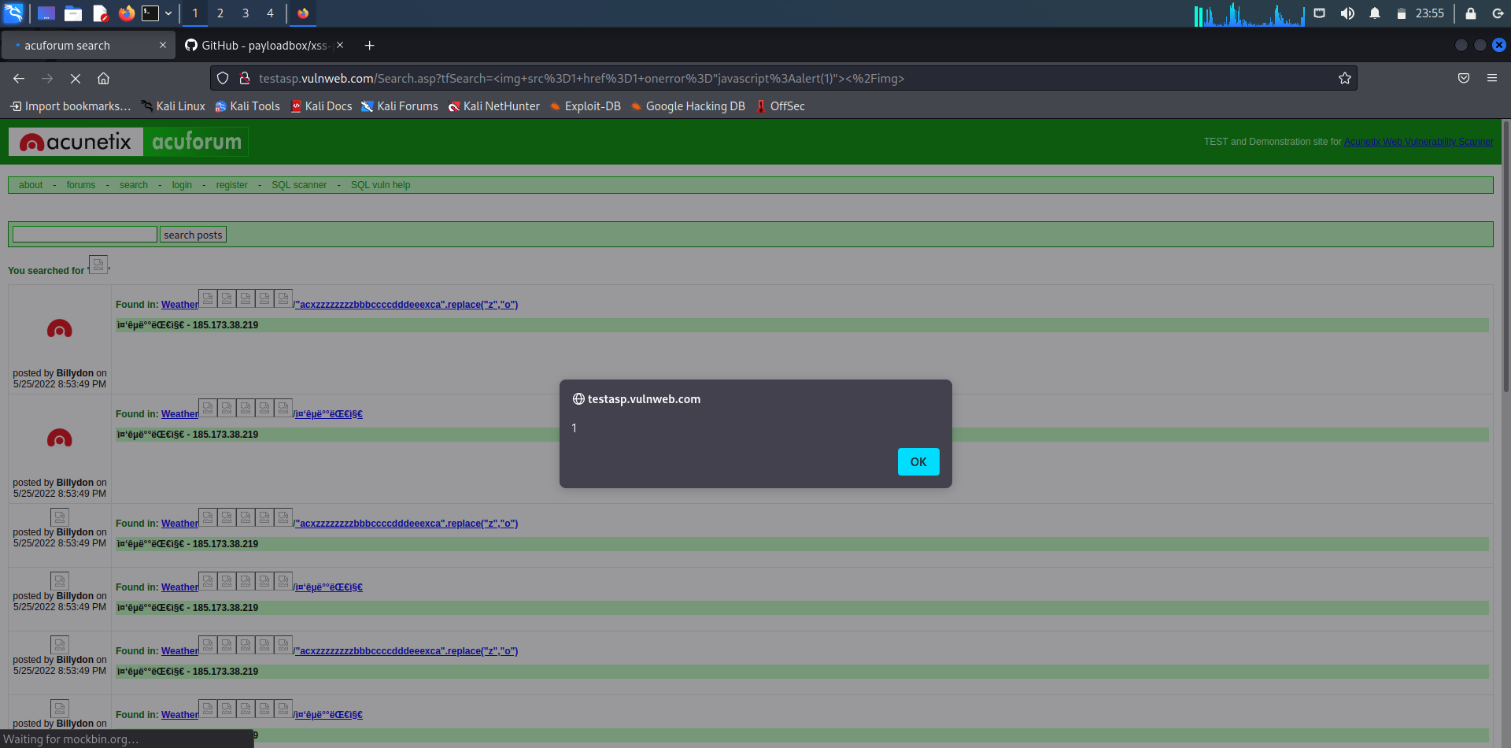
POC

Slide 7
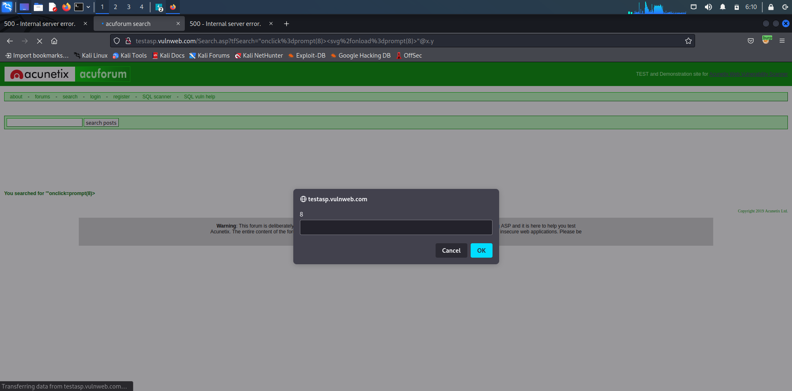
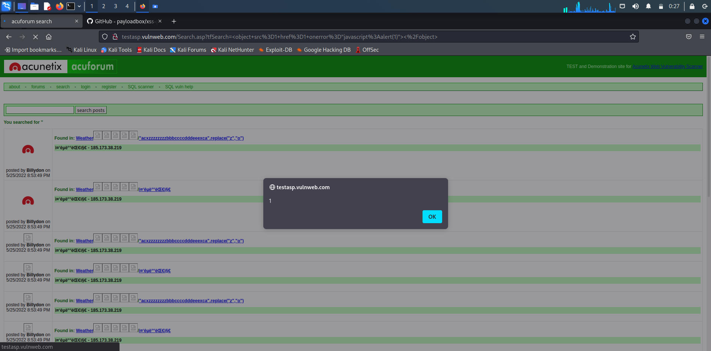

Slide 9
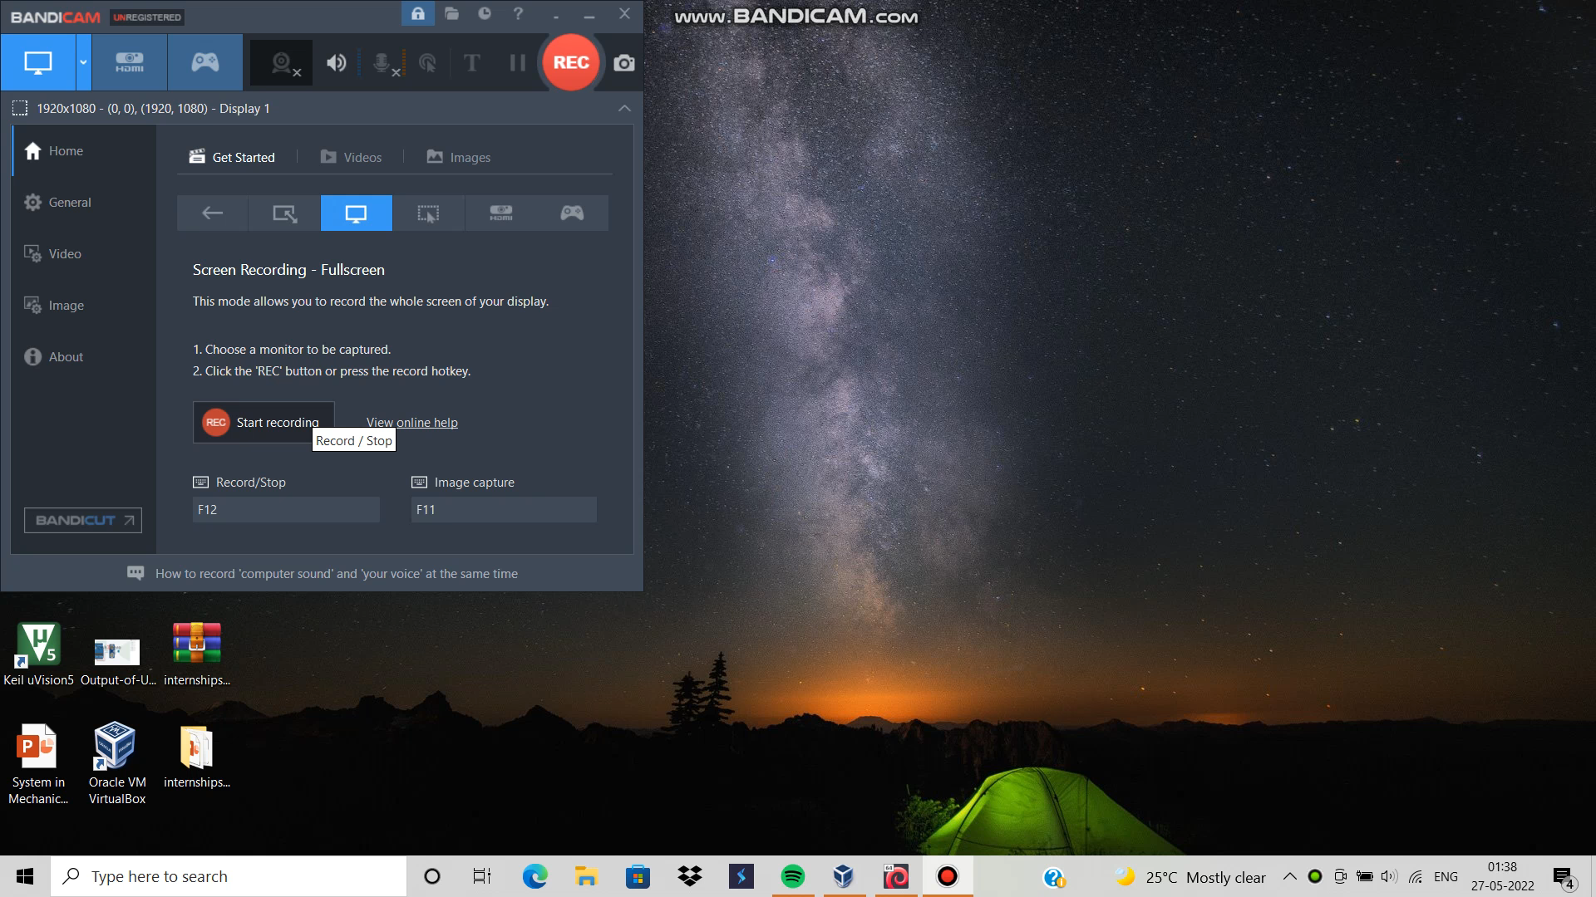
POC: VIDEO

